Slide 1
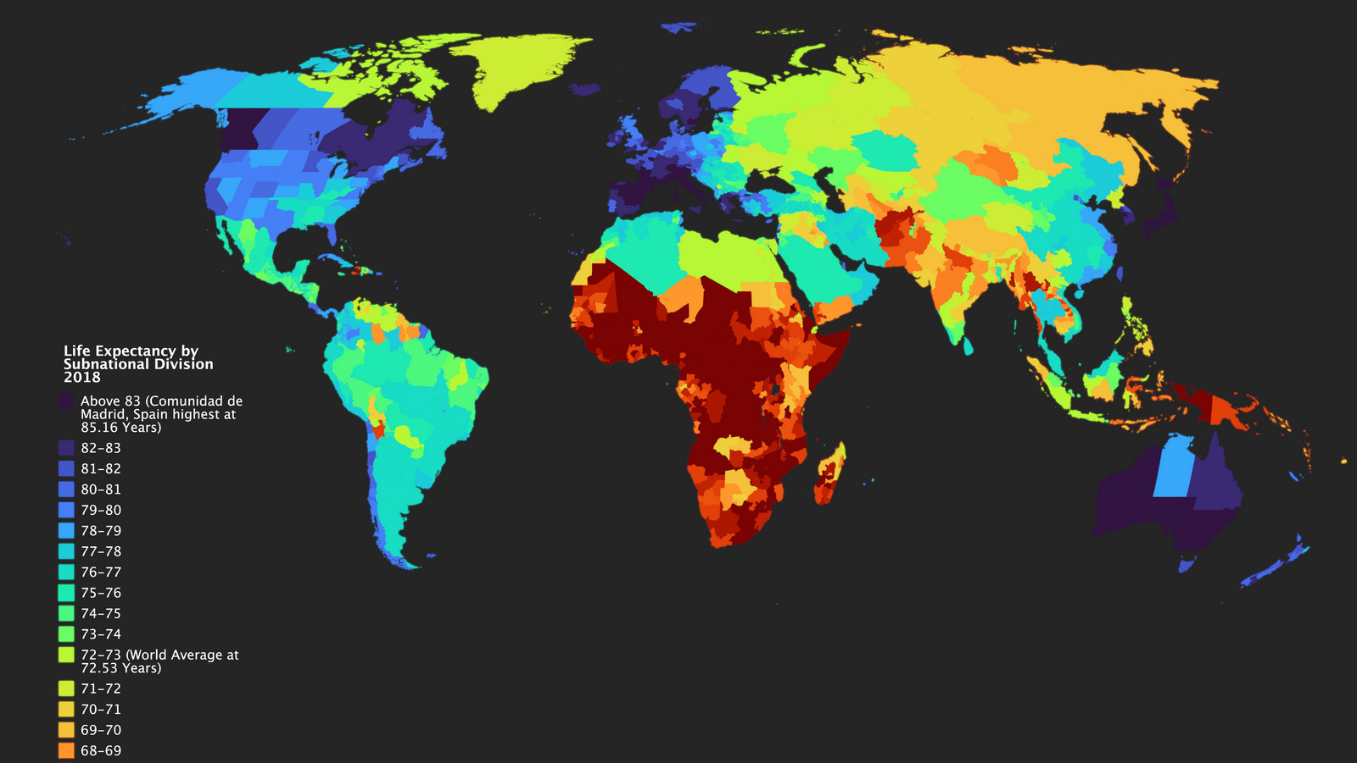

Life expectancy
FACTORS AFFECTING LIFE EXPECTANCY ACROSS THE WORLD

Slide 2

BY
EMMANUEL AKPE

Slide 3
Introduction
Life expectancy is a statistical measure of the average time an individual is expected to live, based on the year of its birth, its current age and other demographic factors.
Accoding to WHO, the global average life expentancy as of 2020 is 72.0 years

Slide 4
Data overview (Life Expectancy, 2000 – 2015)
The Life Expectancy dataset is a collection of various factors that contributes to Life expectancy.
Dataset consists of 22 Columns and 2938 rows comprising 20 predicting variables and 2937 observations
The dataset captures data from 193 countries around the world from the year 2000 to 2015.
Predicting variables are divided into the following categories for easy inferencing:
Immunization related factors
Mortality factors
Health factors
Economic factors and Social factors

Slide 5
Objectives
Identify the overall trend of life expectancy over the period
Determine how immunization against diseases such as polio, diphtheria, measles and hepatitis B affect life expectancy
Identify how economic factors such as GDP, income and total expenditure of citizens impact life expectancy
To know the relationship between mortality factors (such as adult mortality, infant mortality, and under five mortality) and life expectancy
To ascertain how health conditions such as HIV/AIDS and BMI affect life expectancy among countries
To determine how social factors such as alcohol consumption and schooling affect life expectancy

Slide 6





Approach
Data extraction
Data cleaning
Data exploration
Data visualisation
Inference and Conclusion

Slide 7
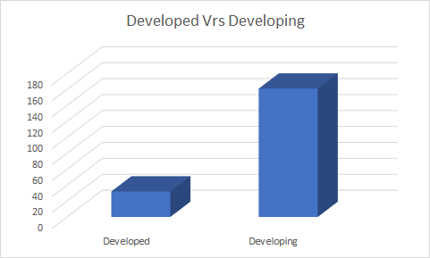
Distribution of Developed and Developing Countries

Slide 8
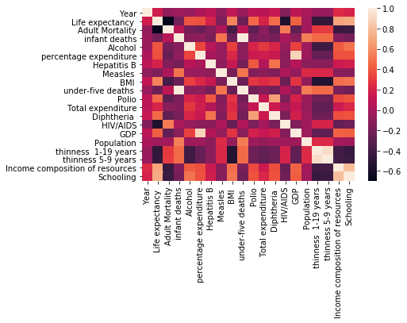
Correlation between the key indicators and Life expectancy

Slide 9
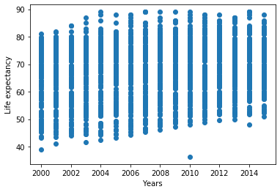
Global Trend of Life Expectancy from 2000 - 2015

Slide 10
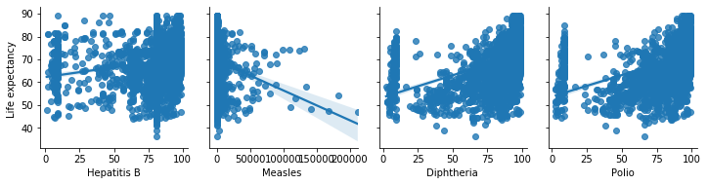
Relationship between immunization factors and Life Expectancy
Positive
Negative
Positive
Positive

Slide 11
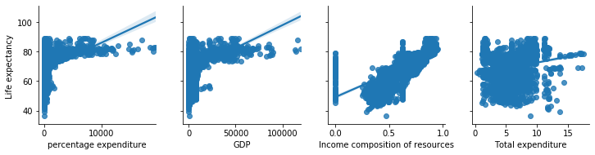
Relationship between economic factors and life expectancy
Positive
Positive
Positive
Positive

Slide 12
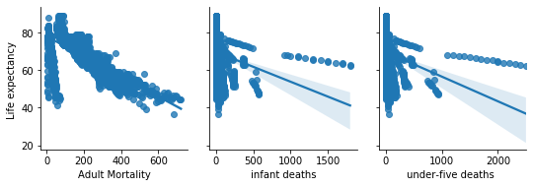
Relationship between mortality factors and life expectation
Negative
Negative
Negative

Slide 13
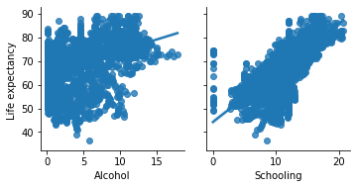
Relationship between social factors and life expectancy
Positive
Positive

Slide 14
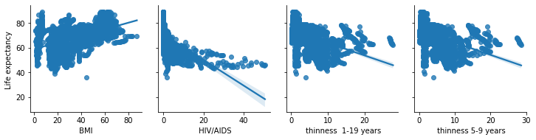
Relationship between health factors and life expectancy
Positive
Negative
Negative
Negative

Slide 15
Conclusion
Life expectancy among countries assumed an upward trend over the years from 2000 to 2015.
Immunization against diseases such as such as Polio, Measles, Diphtheria and Hepatitis B leads to increase in Life Expectancy.
Economic factors such as GDP of a country, percentage of expenditure on health, income from resources and total expenditure individually accounts for higher life expectancy.

Slide 16
Conclusion
Our findings revealed that mortalities such as adult mortality, infant mortality and under-five mortality negatively impacts Life expectancy. T
In addition, we explored the relationship between life expectancy and some social factors such as schooling. We found that these social factors are positively related to Life expectancy.
Finally, the analysis reveals that life expectancy is negatively impacted by other health issues such as HIV/AIDS and thinness while BMI directly affects Life expectancy.

Slide 17
Recommendations
Governments should ensure immunization against diseases such as polio, diphtheria, measles, and hepatitis B.
Government should implement economic policies that will lead to reduced inflation and interest rates that boost economic growth.

Slide 18
Recommendations
The government should implement interventions that ensures that education, especially basic education, is made accessible to all of its citizens.
Governments should invest in its health care systems to ensure that its people get access to quality health care to reduce mortality rates.

Slide 19
THANK YOU

